Slide 1
Loan Management System
Presentation by Batch 9, Team 4
Team Members:
Anjan
Garima Sharma
Rajat Agarwal
Subhradeep Maiti
Sweta Chakravarthi

Slide 2
Table of Contents

Slide 3

Project Overview
Loan Management System (LMS) provides a facility for Employees to purchase items from an internal Mart and facilitates a flexible loan option to purchase and then repay the loan within specific duration.
Any employee can apply for loan and the admin acts as the approver for the loan requests.

Slide 4
Project Functionalities
Following are the major functionalities of this Project:-
Employee can register themselves on the application and login using credentials.
Employee can apply for loan and view existing loans
Admin can view all loans and can approve or reject them.
Admin can manage loan cards ie, can define loan item and their valuations.
Admin can maintain Item Master Database, Loan Master Database and Customer Master Database

Slide 5
Project Architecture

Slide 6

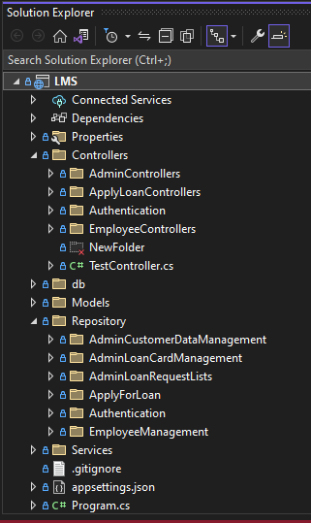
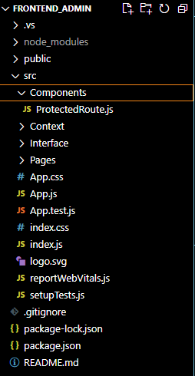
CodeBase

Slide 7
User Interface

Slide 8
Database Integration
We used Database-First approach to start with the development process.

Slide 9
Testing

Slide 10
Challenges
Lack of experience with the given tech stack among team-mates.
Limited time to discuss, assign and work on any given functionality.
Limited scope for errors and learn from them due to less time.

Slide 11
Future Scope
Register functionality can be extended to allow more authorised users to request admin account. This request can be approved by existing admins.
User functionality to display all items that are available or if not available currently, then their tentative date of availability.
Scope for better and more intuitive user interface.
Admin functionality to view the total loan amount for all active loans.
Application can utilise machine learning algorithms to suggest items during apply loan process based on user’s past behaviour.

Slide 12
Individual Contribution
Name | Contribution
Anjan | Database Schema, Customer Management API, Loan Data Management API, Item Data Management API, Employee Apply for Loan API, API to Get Loans and Items by Emp ID, API Testing, Apply Loan UI
Garima | Register API, Apply Loan UI, Display Loans and Items UI, Admin Customer Management UI, Admin Loan Data Management UI, Admin Item Data Management UI
Rajat | Login API, Register API, Item Data Management API, API Testing
Subhradeep | Register UI, Login UI, styling of all pages including- forms and tables
Sweta | Admin Customer Management UI, Admin Loan Data Management UI, Admin Item Data Management UI

Slide 13
DEMO

Slide 14

Thanks!

